Slide 1
Discrete Structures for Computer Science
(CS F222)
Topic: Graph Theory (Trees)
Dr. Raghunath Reddy

Slide 2
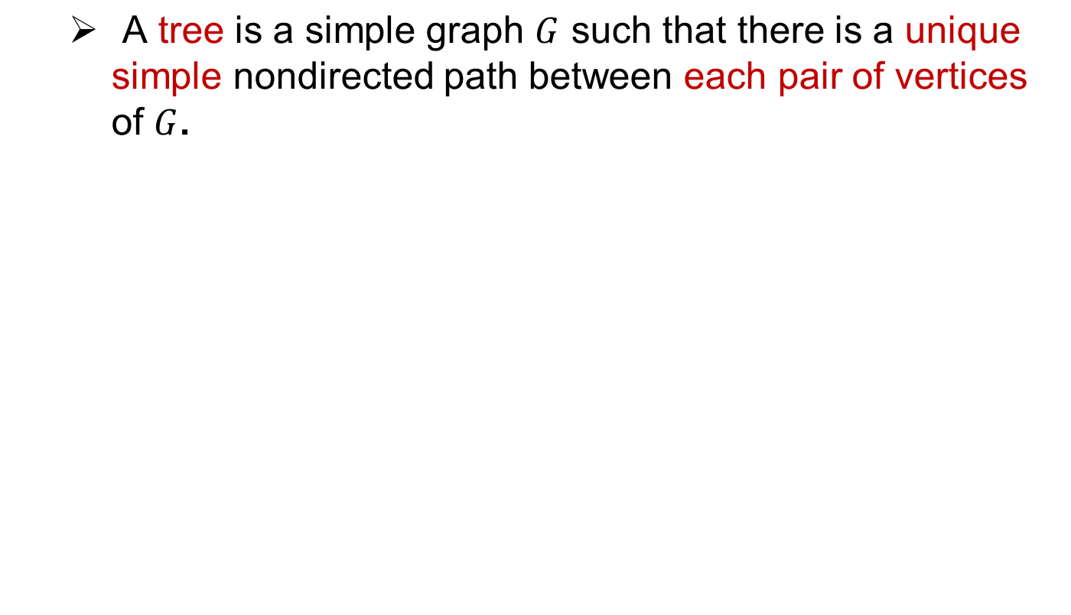
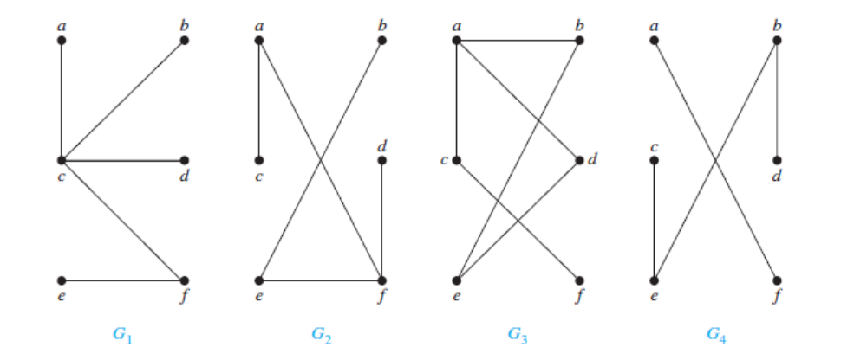
Introduction

Slide 3
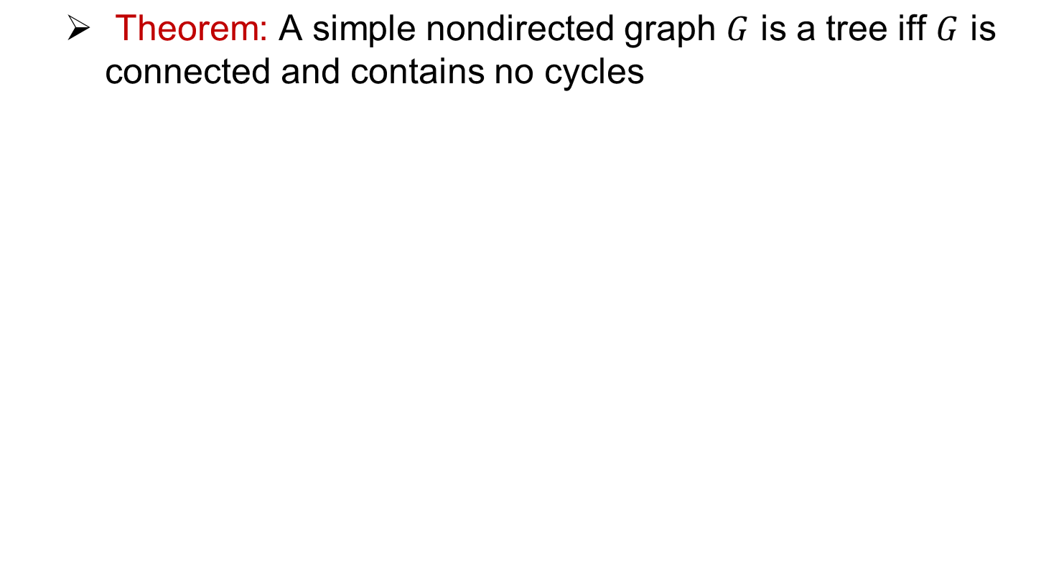
Important result

Slide 4
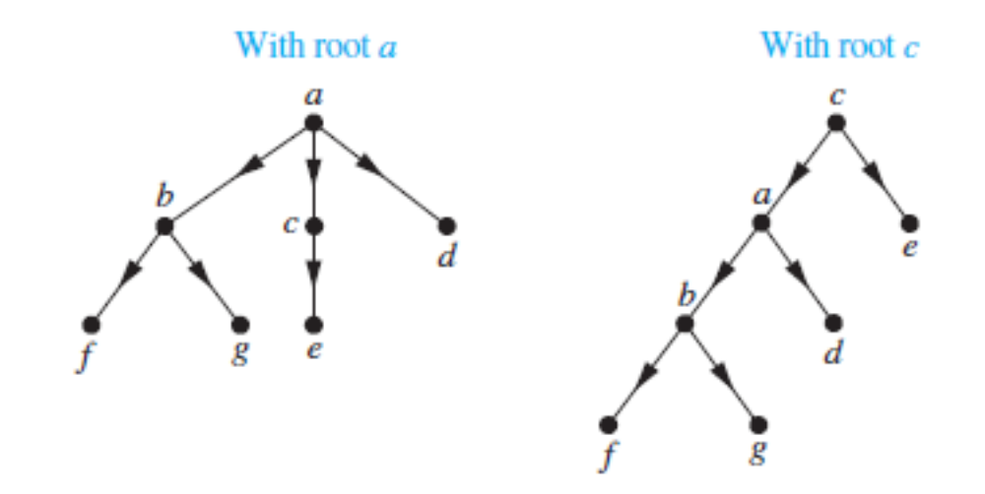
Rooted trees
  A rooted tree is a tree in which there is one designated vertex, called root.
  A rooted tree is a directed tree if there is a root from which there is a directed path to each vertex.

Slide 5
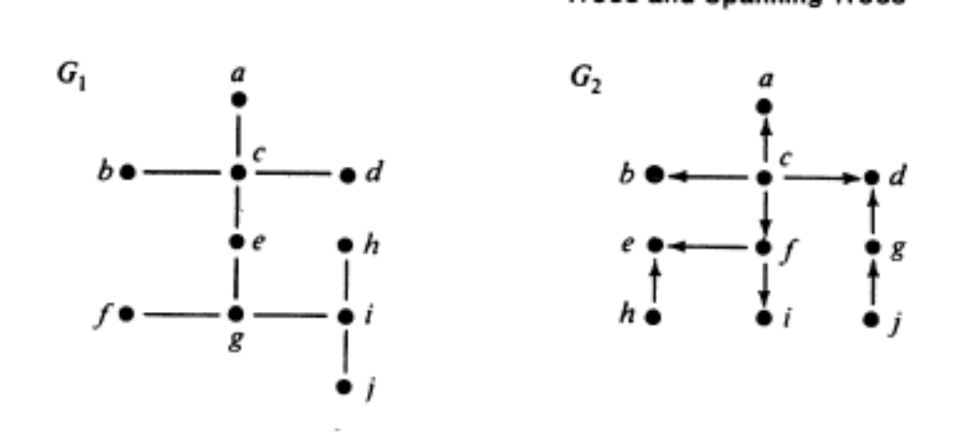
Directed trees

Slide 6
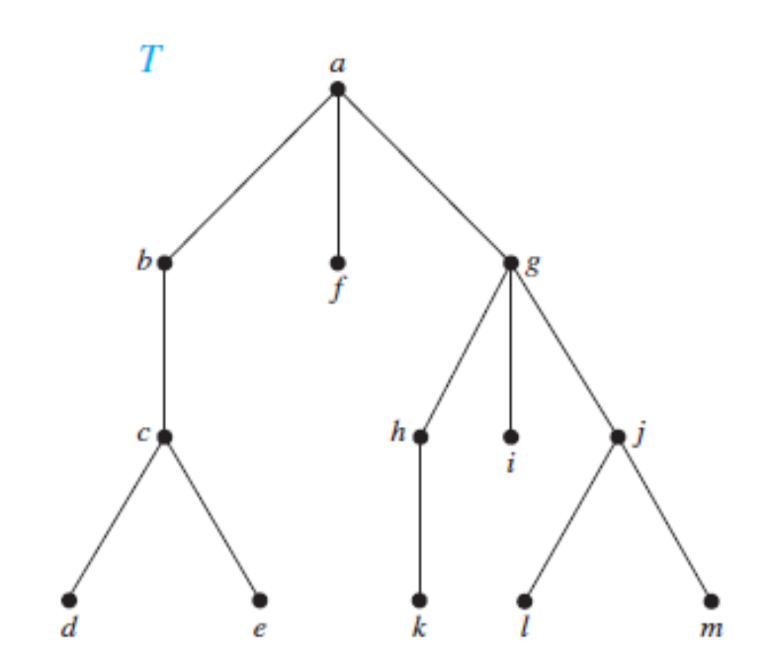
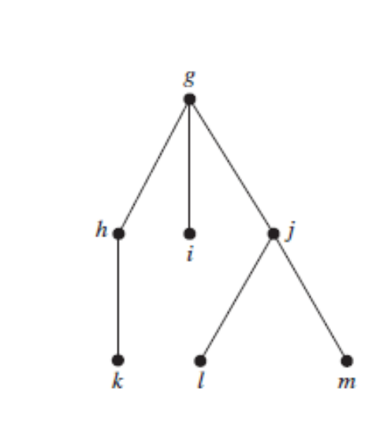
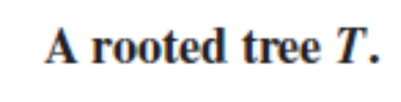

More on rooted trees

Slide 7
Terminology
Parent
Child
Siblings
Leaf node
Internal node

Slide 8
Terminology
Level of a node
Height of a tree

Slide 9
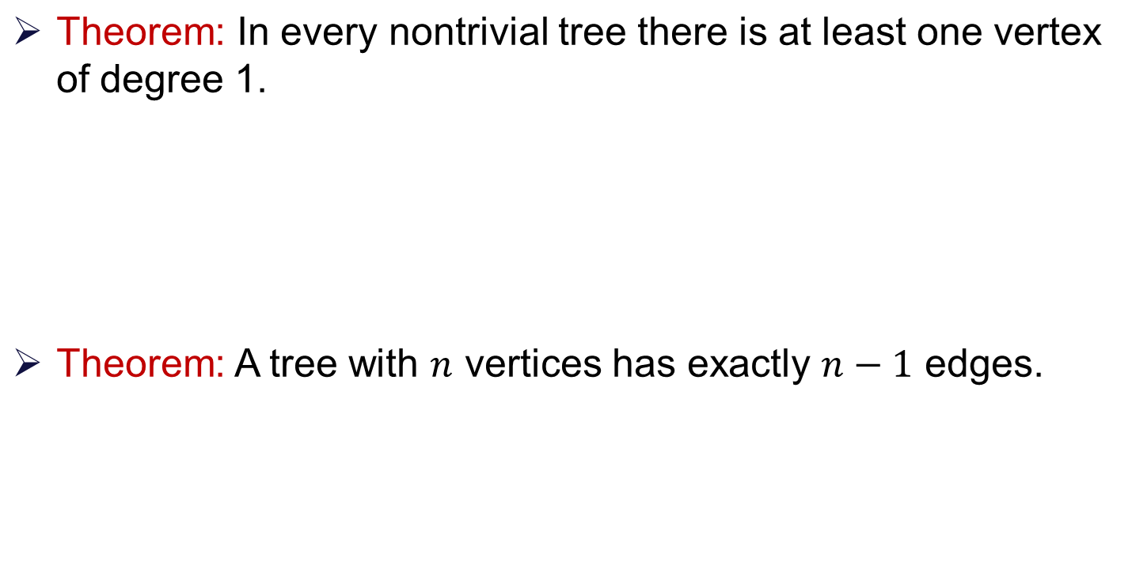
Some properties of Trees

Slide 10
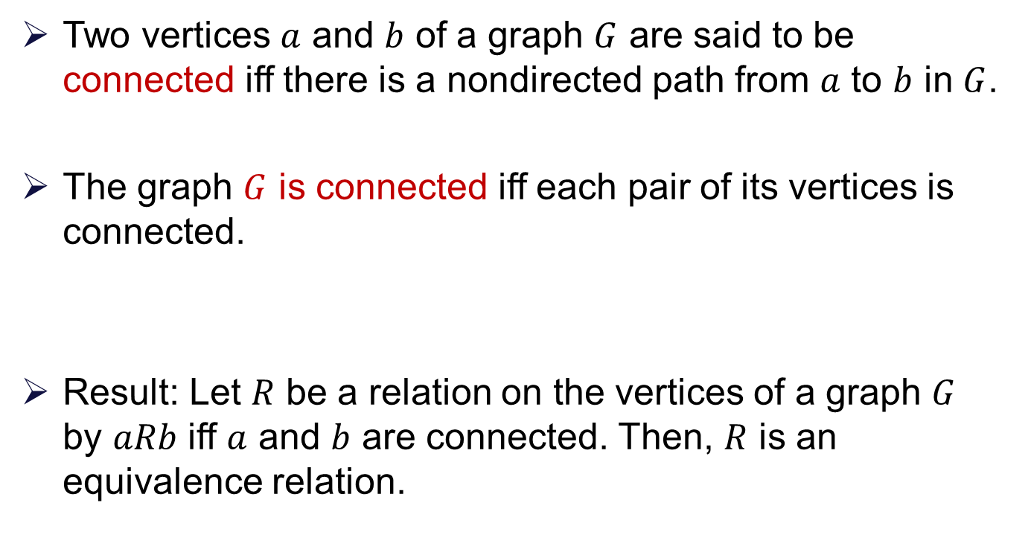
Connectedness: Revisit

Slide 11
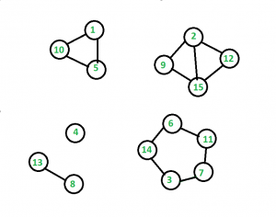
Connected Components

Slide 12
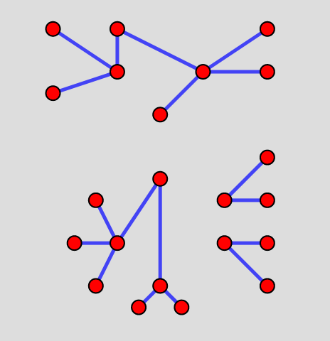
Forest

Slide 13
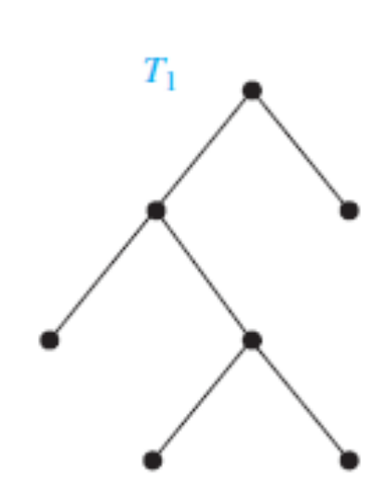
Binary trees
A rooted tree is called binary tree if every internal vertex (including root) has no more than 2 children.
Left and right subtrees

Slide 14
Binary trees
A rooted tree is called binary tree if every internal vertex (including root) has no more than 2 children.
Left and right subtrees

Slide 15
Binary trees (applications)
Representing mathematical expressions

Slide 16
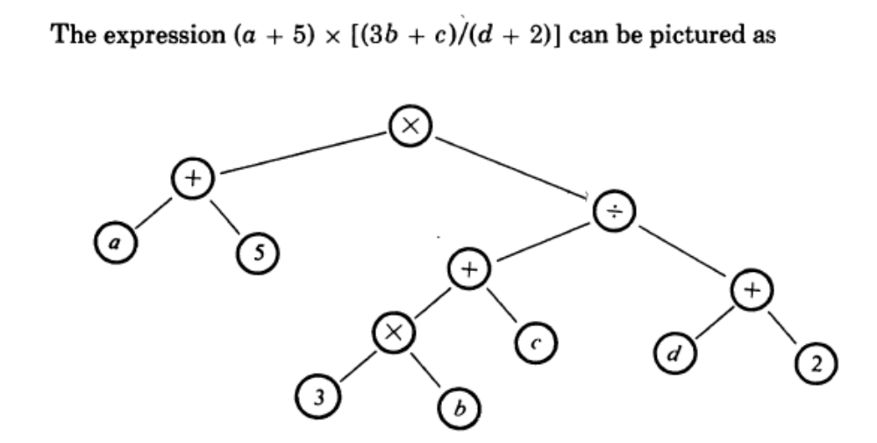
Binary trees (applications)
Representing mathematical expressions

Slide 17
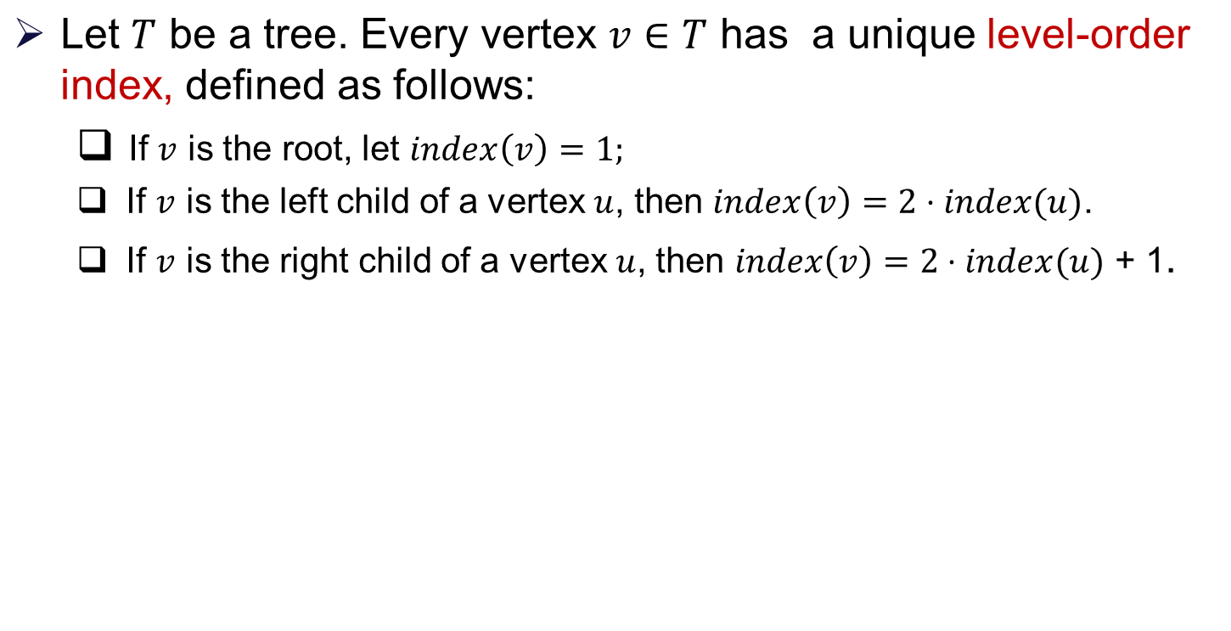
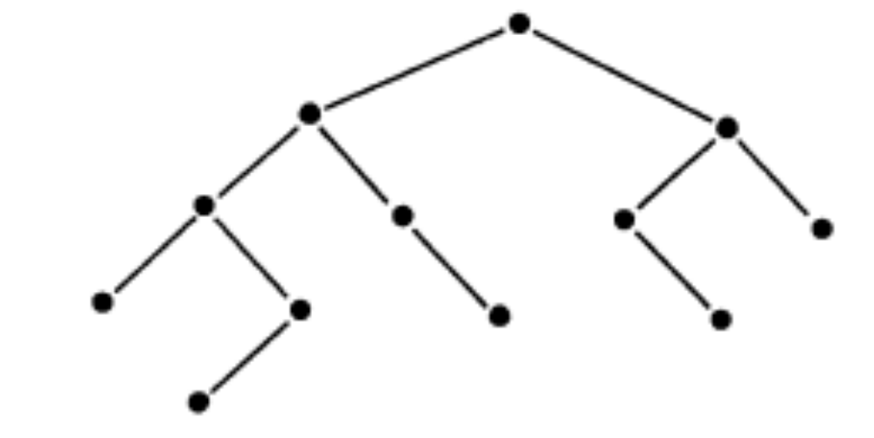
Complete binary tree

Slide 18
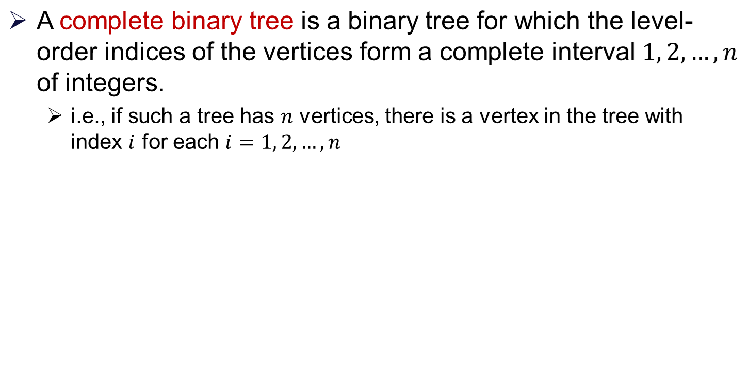
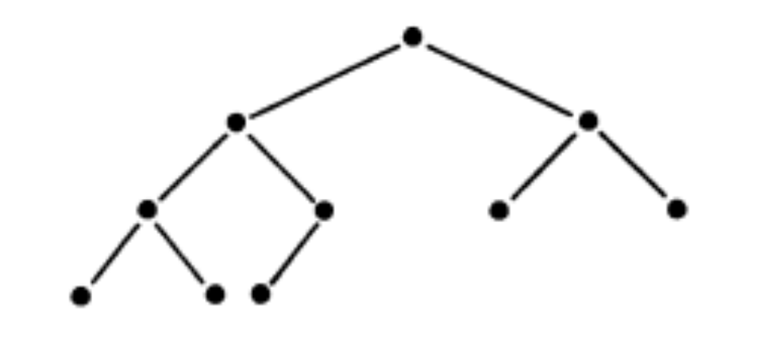
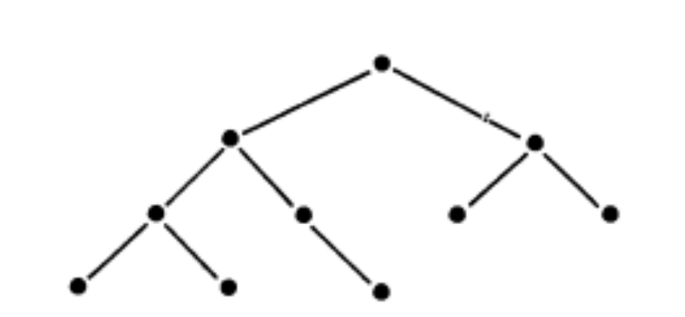
Complete binary tree

Slide 19
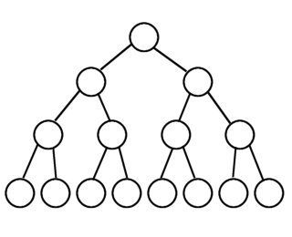
Full binary tree
A full binary tree (sometimes proper binary tree or 2-tree) is a tree in which every node other than the leaves has two children.

Slide 20
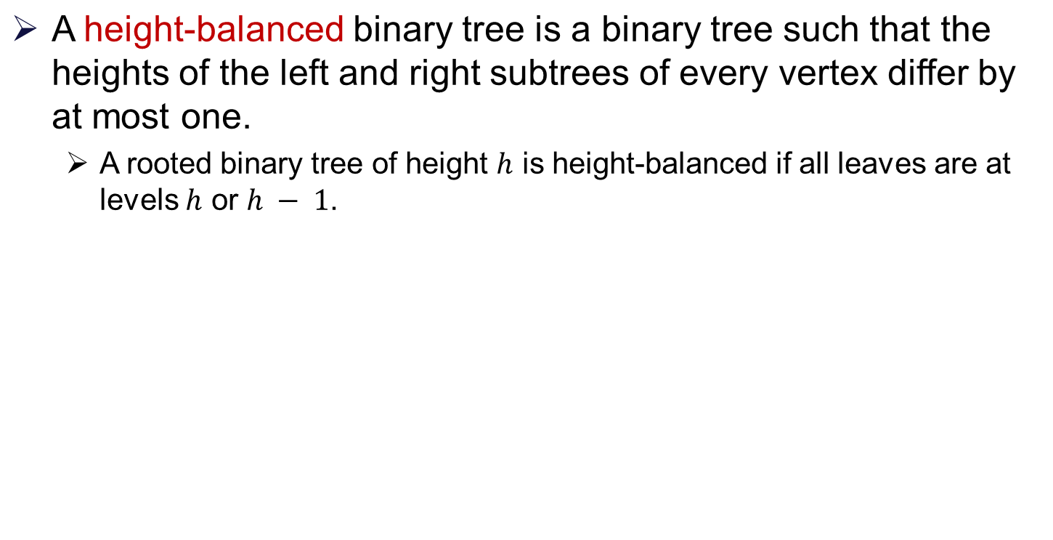
Height-balanced binary tree

Slide 21
Spanning Trees

Slide 22
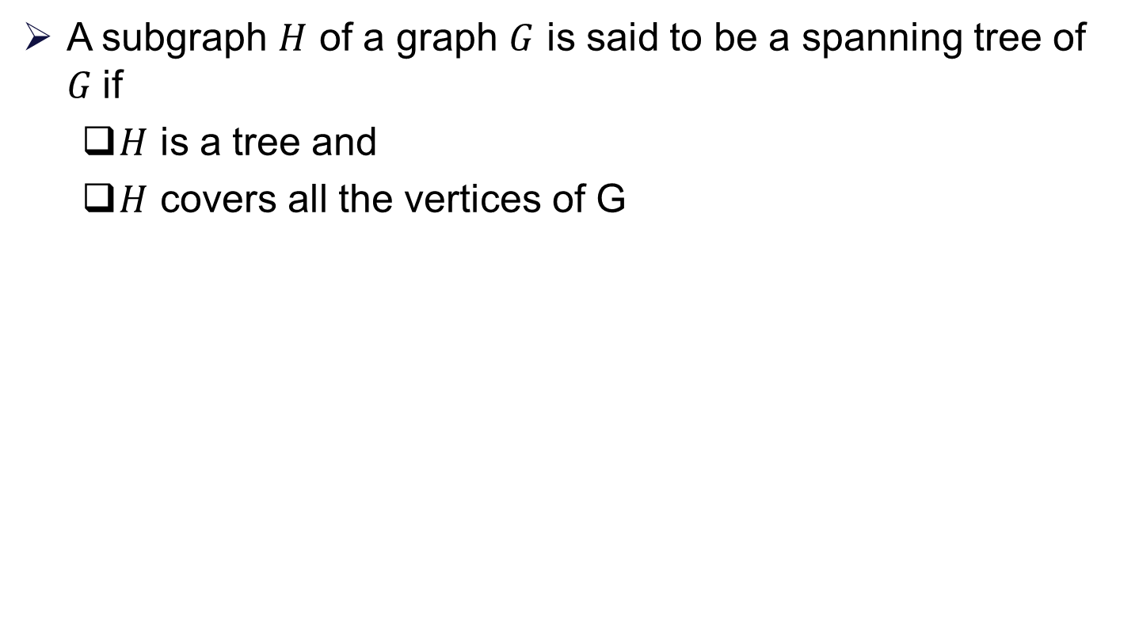
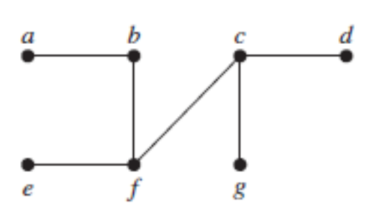
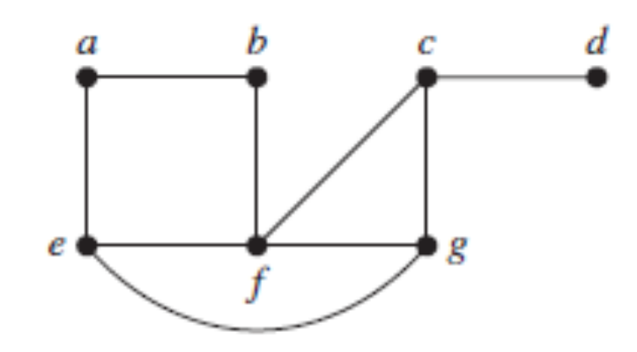
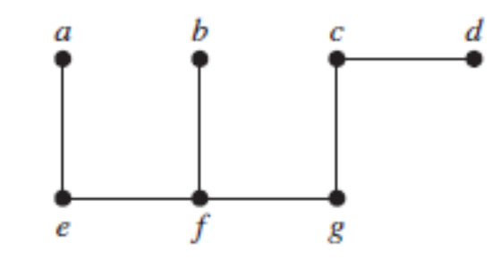
Spanning tree

Slide 23
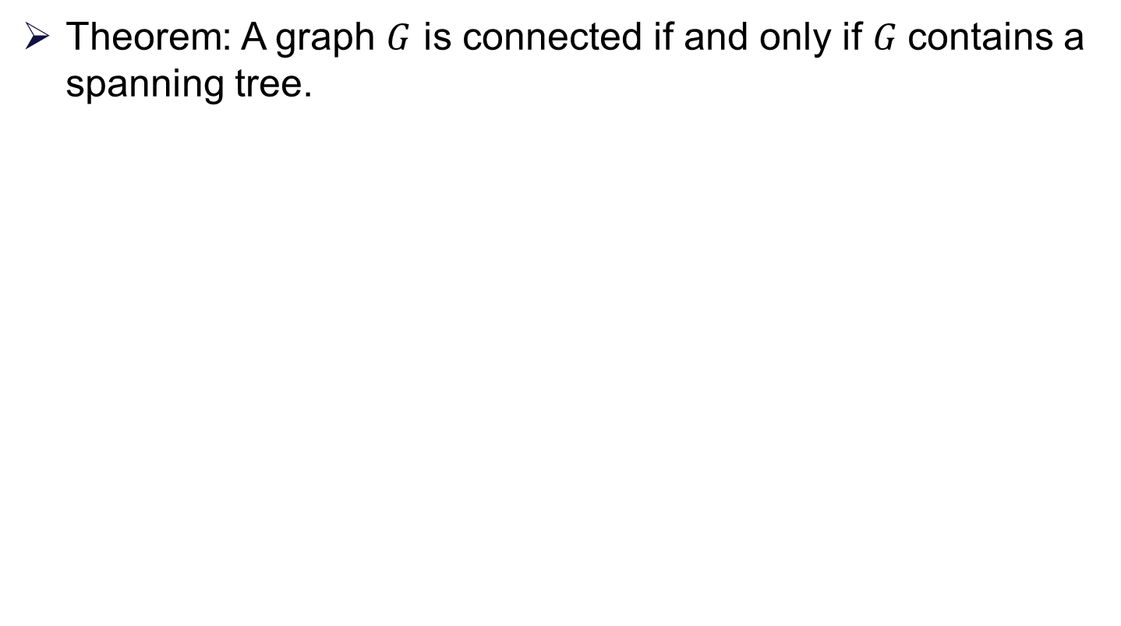
Spanning tree

Slide 24
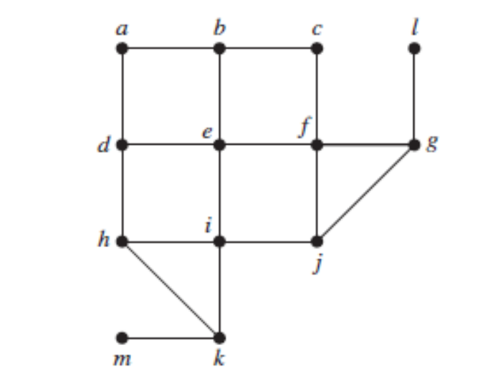
Breadth-first search (BFS)

Slide 25
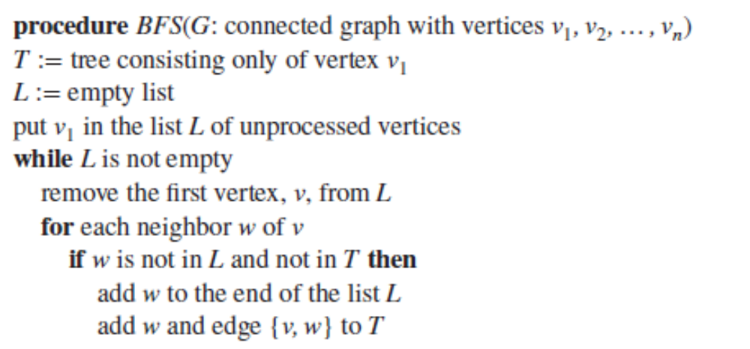
Breadth-first search (BFS)

Slide 26
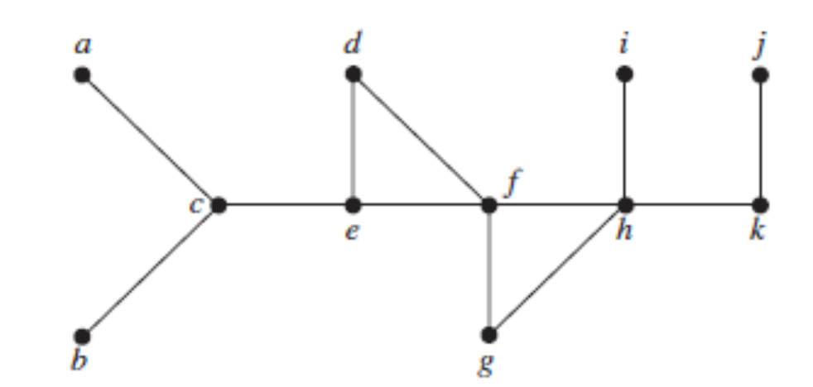
Depth-first search (DFS)

Slide 27
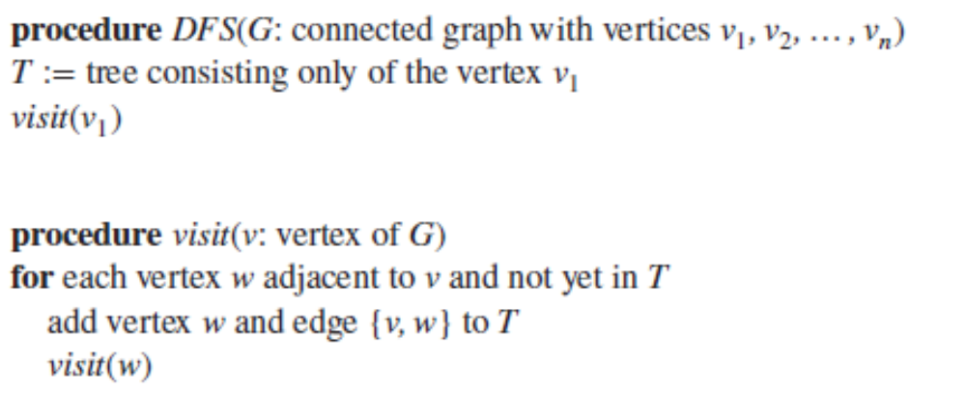
Depth-first search (DFS)

Slide 28
Thank You!!

